Slide 1

Predicting the price of Apple Stock

Slide 2

Business Context
Recession
Predictive modelling to make informed decisions whether to buy, hold or sell

Slide 3

Business Question
Can investing small amount early helps to generate more wealth?
Can you predict the stock market to gain more profit?
Can you minimize the risk by looking at the trends

Slide 4
Importance of Question
Get insights
Generate wealth

Slide 5

Data Pipeline
DATA EXTRACTION
DATA PRE-PROCESSING
DATA ANALYSIS
MODEL BUILDING
MODEL SUMMARY
RECOMMENDATION& CONCLUSION

Slide 6



Data Extraction

Slide 7

Exploratory Data Analysis

Slide 8
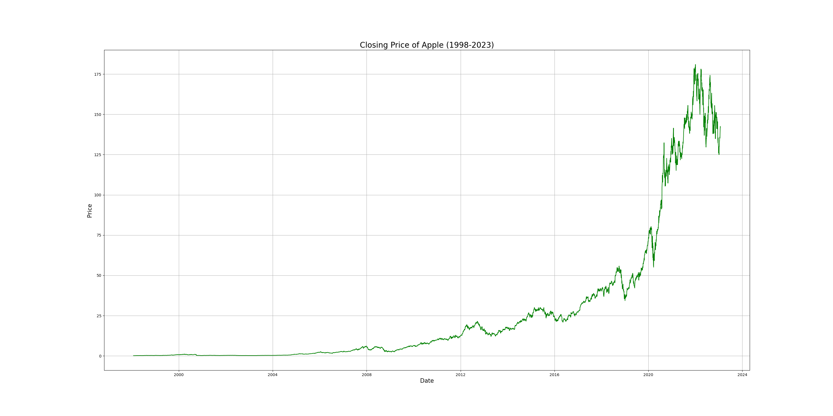

Slide 9
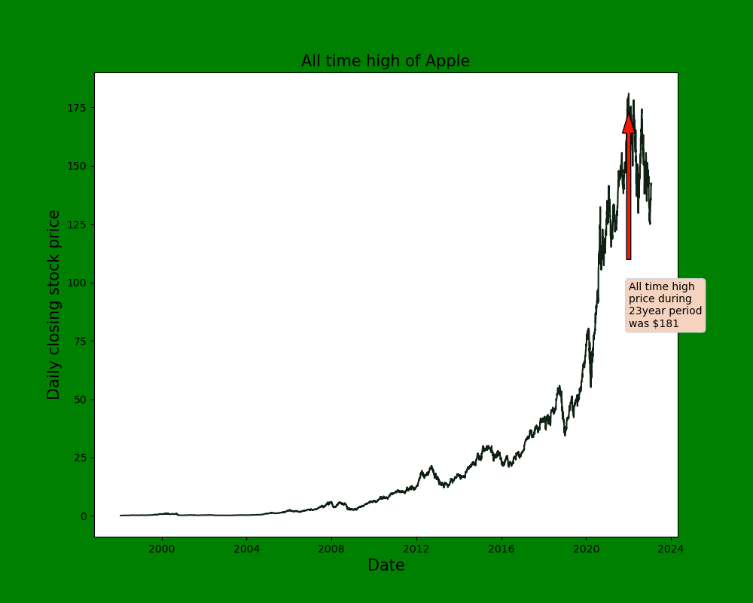

Slide 10
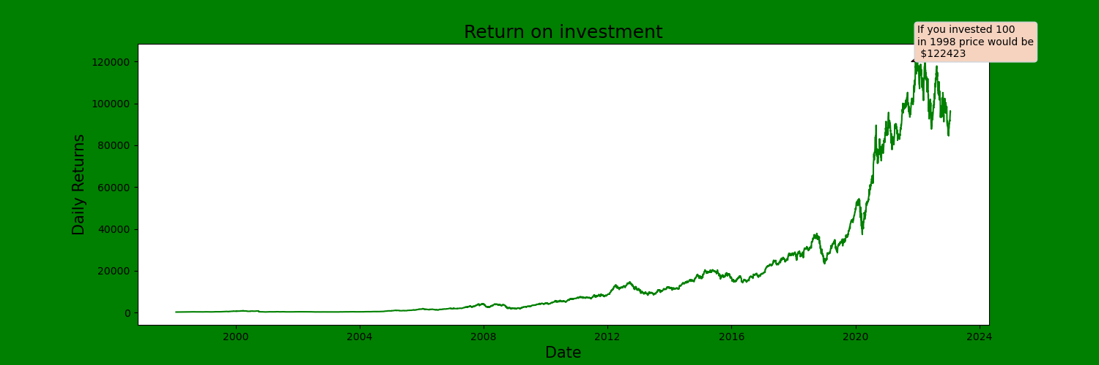

Slide 11
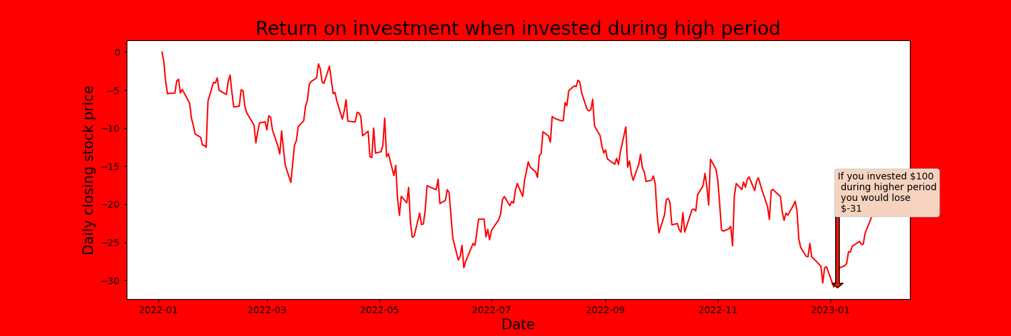

Slide 12

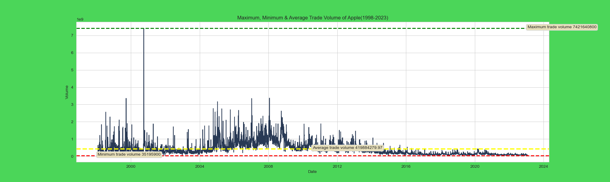

Slide 13
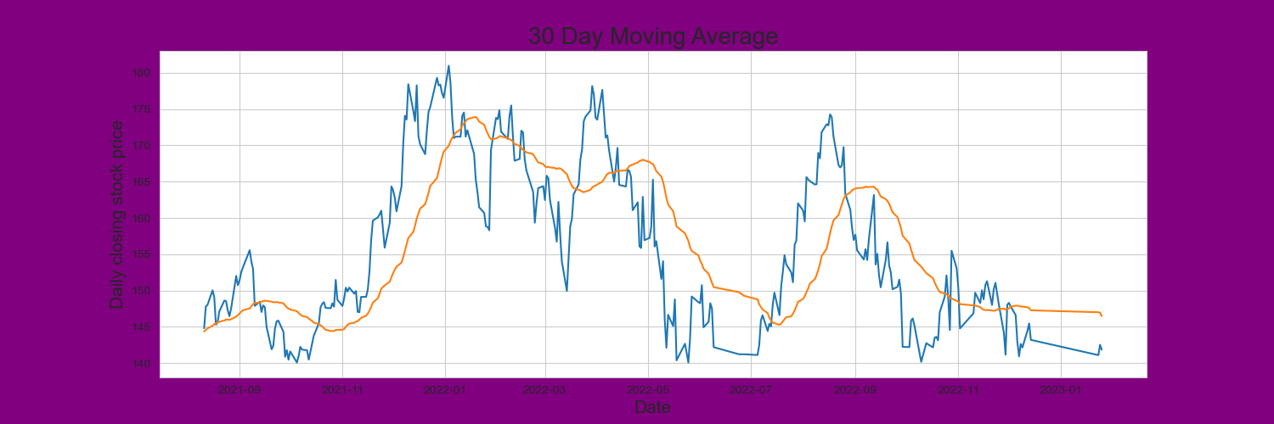

Slide 14


